Slide 1
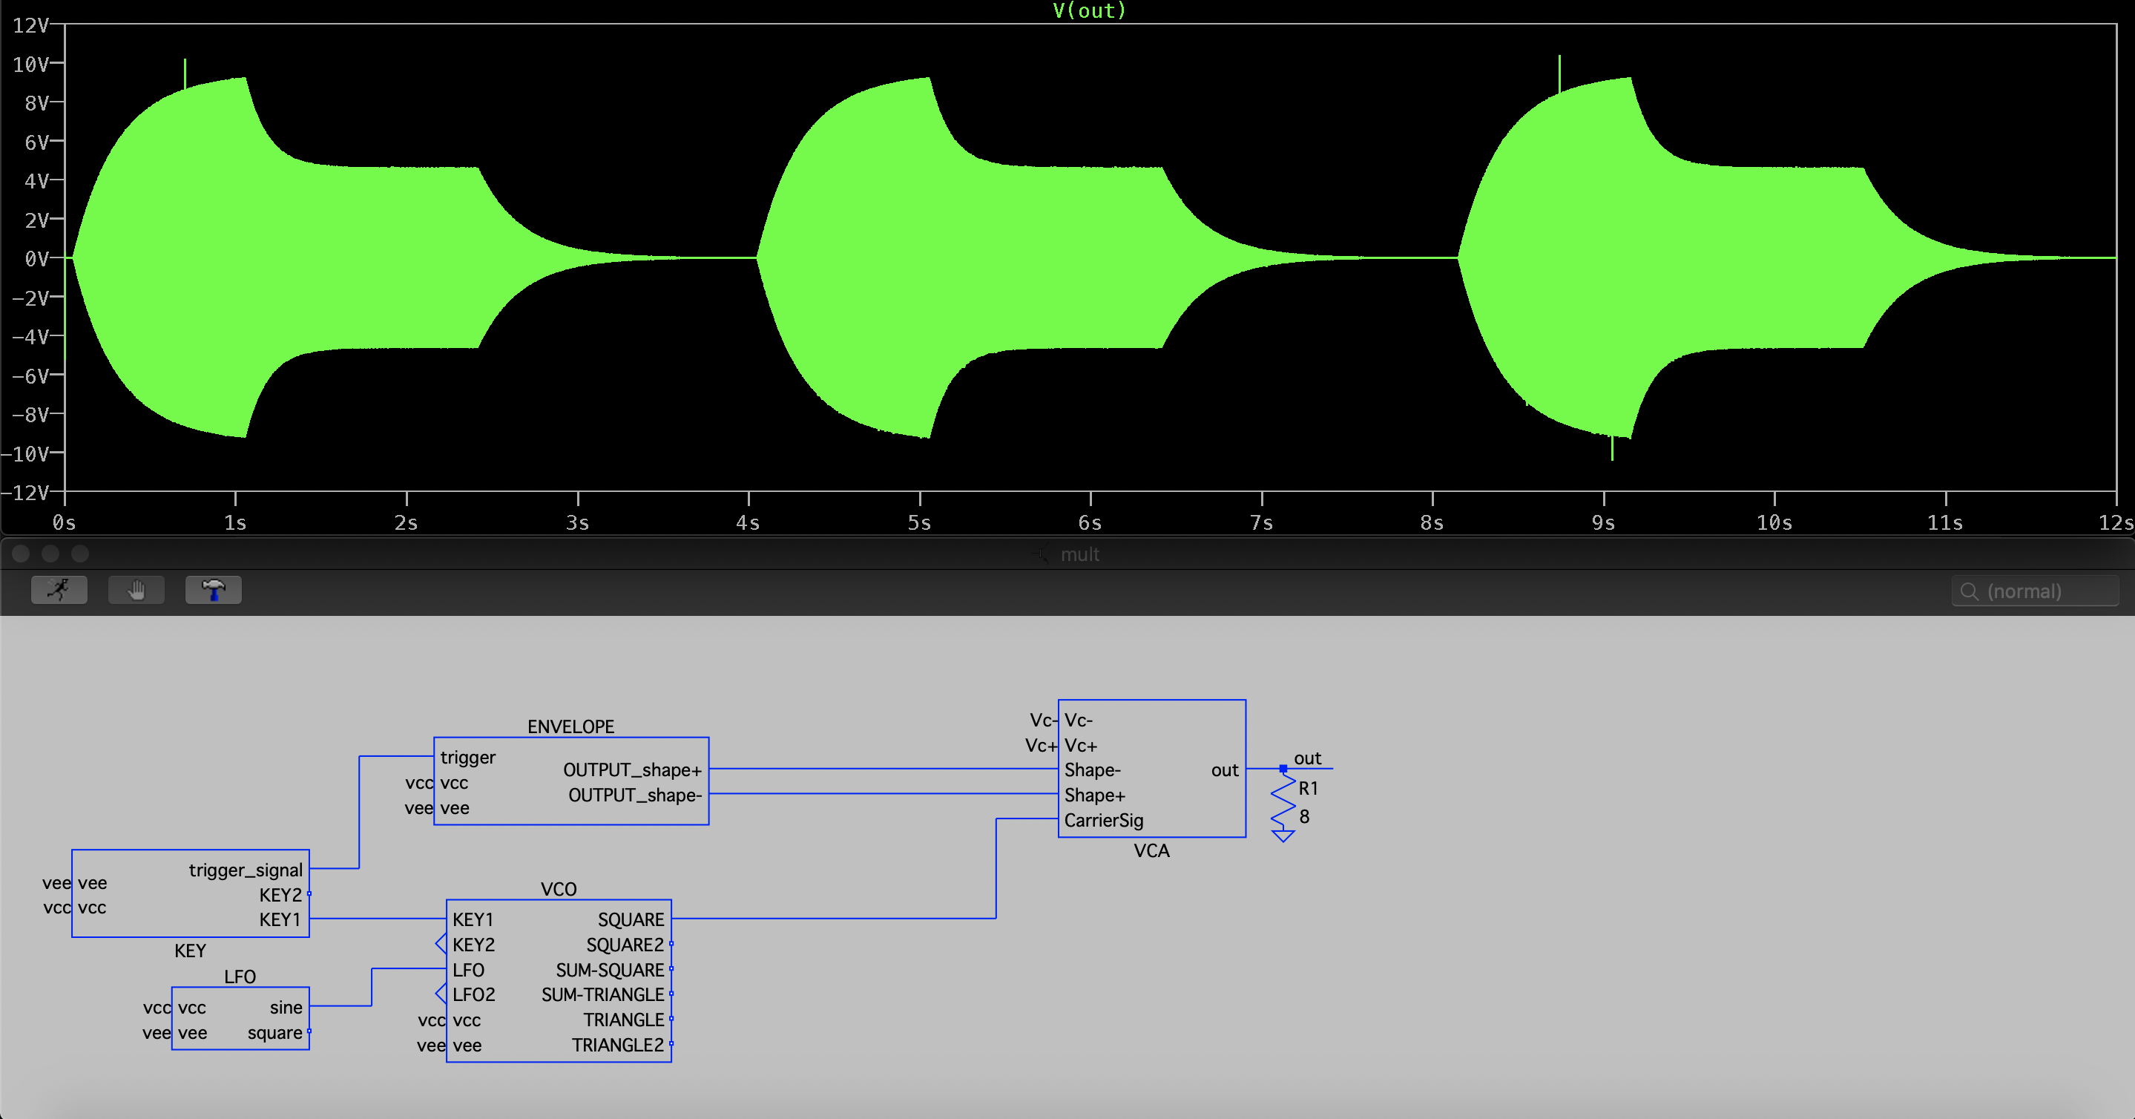
AM: Envelope
FM: LFO - sine (vibrato)
Key: Key1
VCO: Square
This combination varies the frequency of the notes periodically.

Slide 2
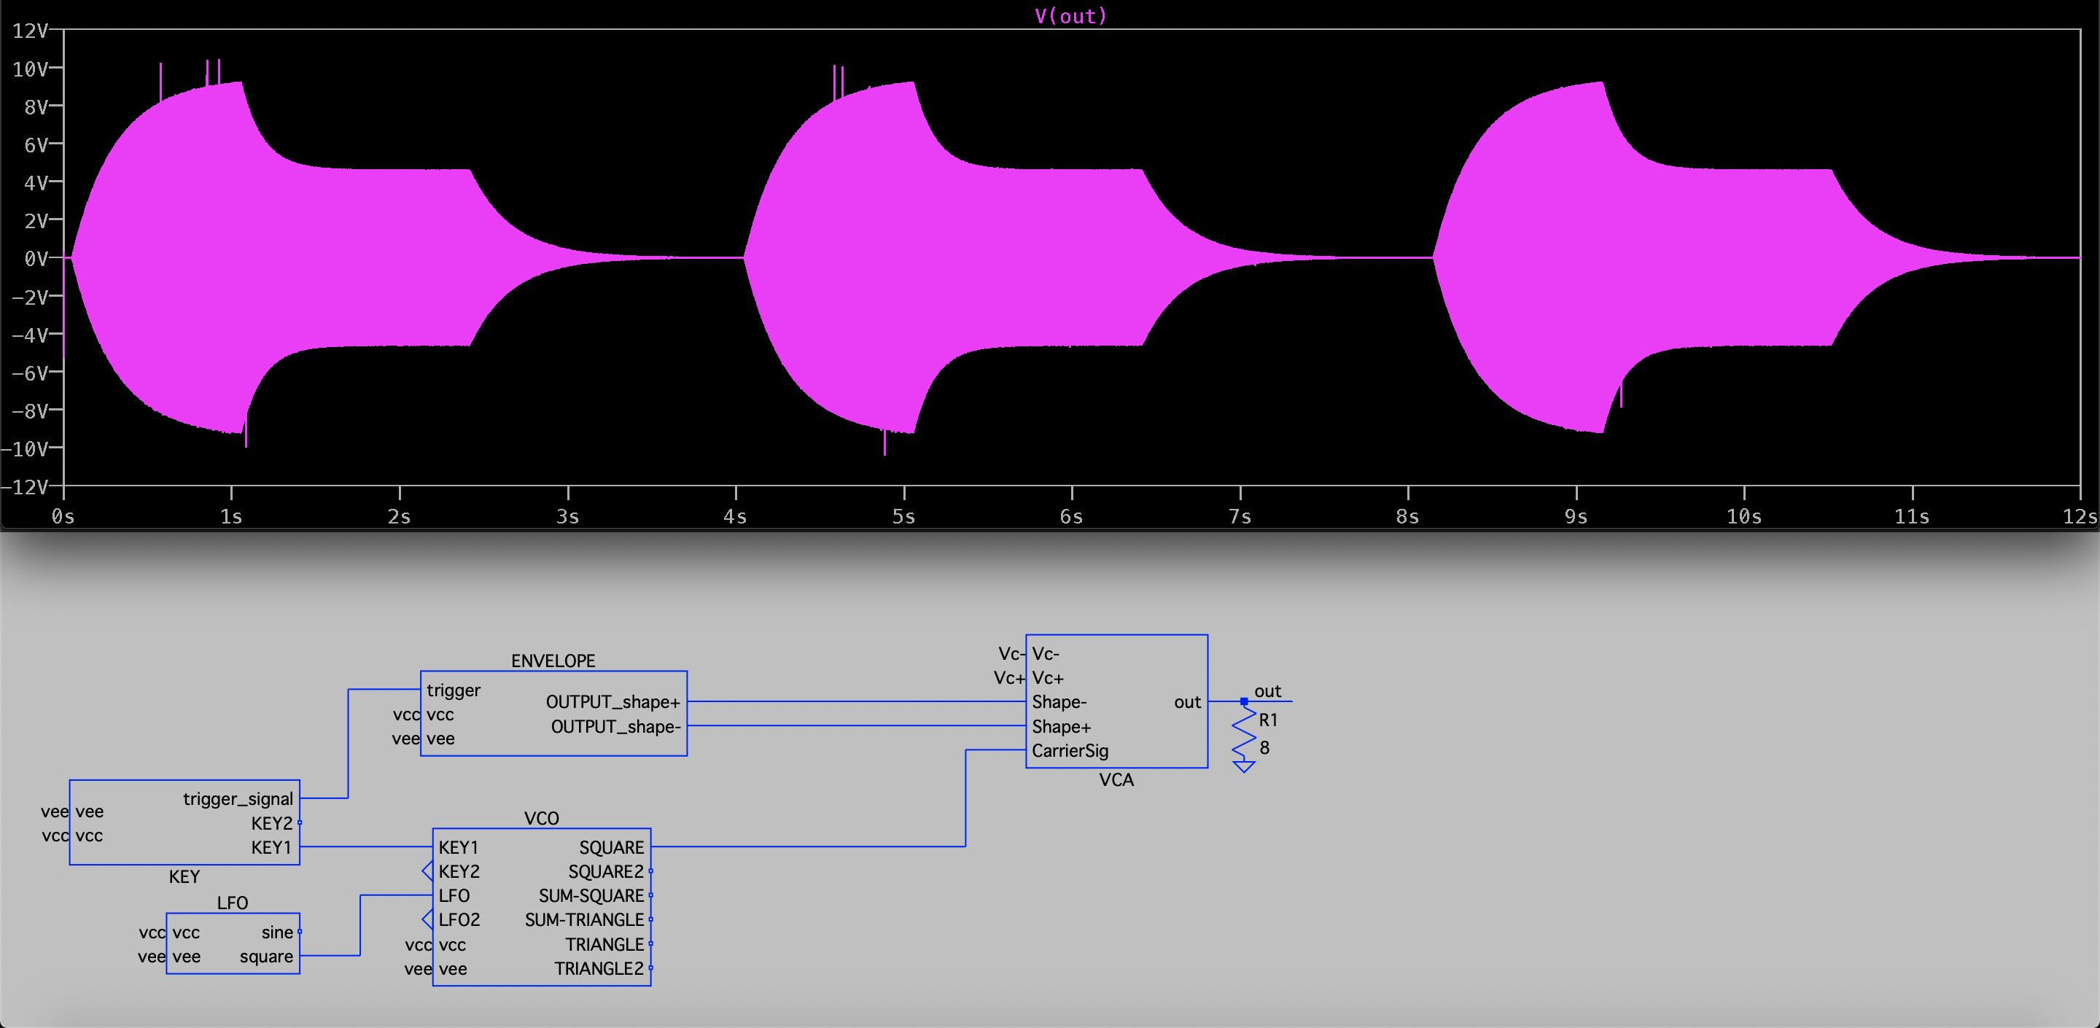
AM: Envelope
FM: LFO - square (trill)
Key: Key1
VCO: Square
This combination varies the frequency of the notes abruptly.

Slide 3
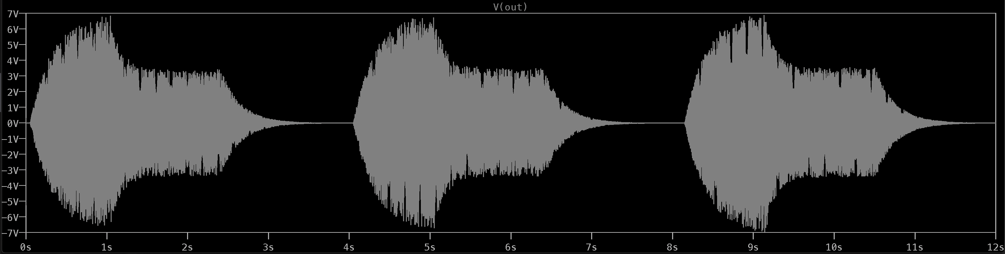

AM: Envelope
FM: LFO - sine (vibrato)
Key: Key1 + Key2
VCO: Summed Triangle
This combination varies the amplitude of the Key1 notes periodically while keeping the Key2 notes are untouched.

Slide 4
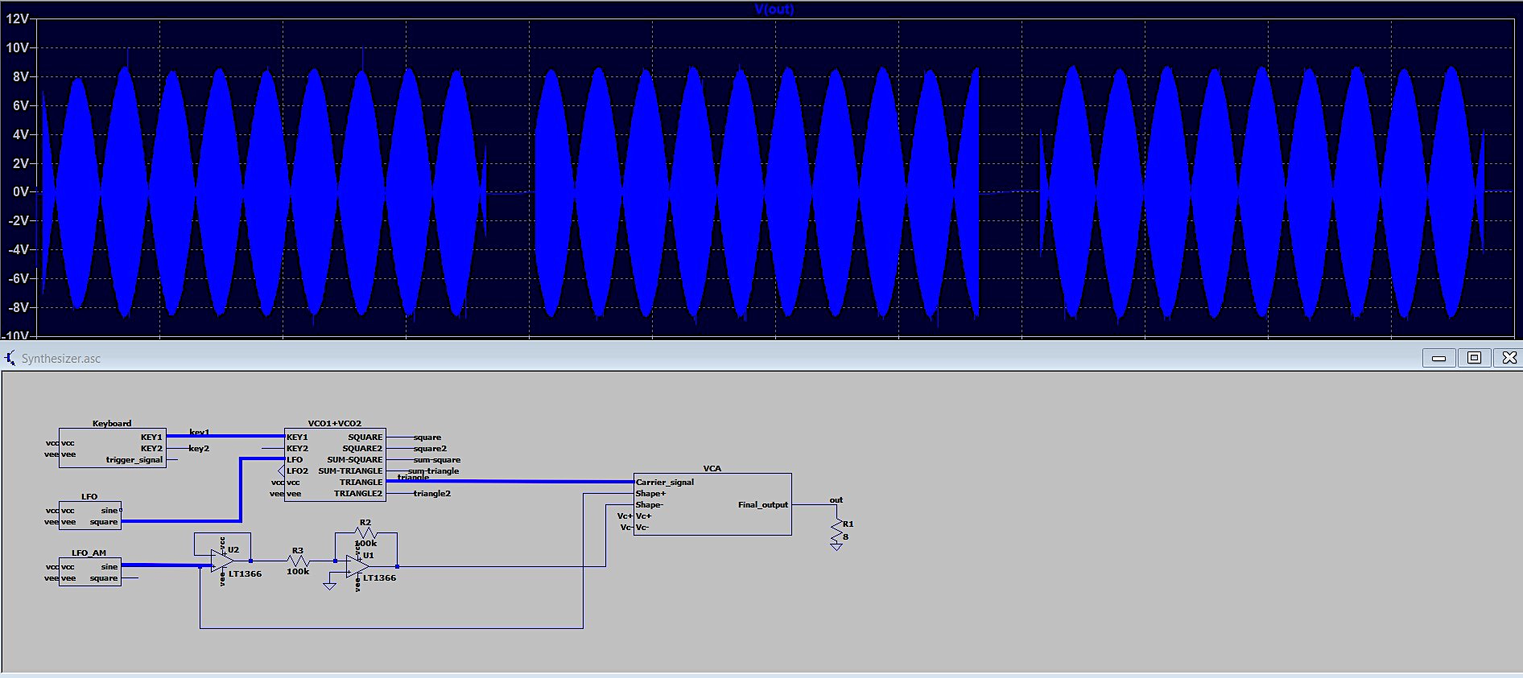
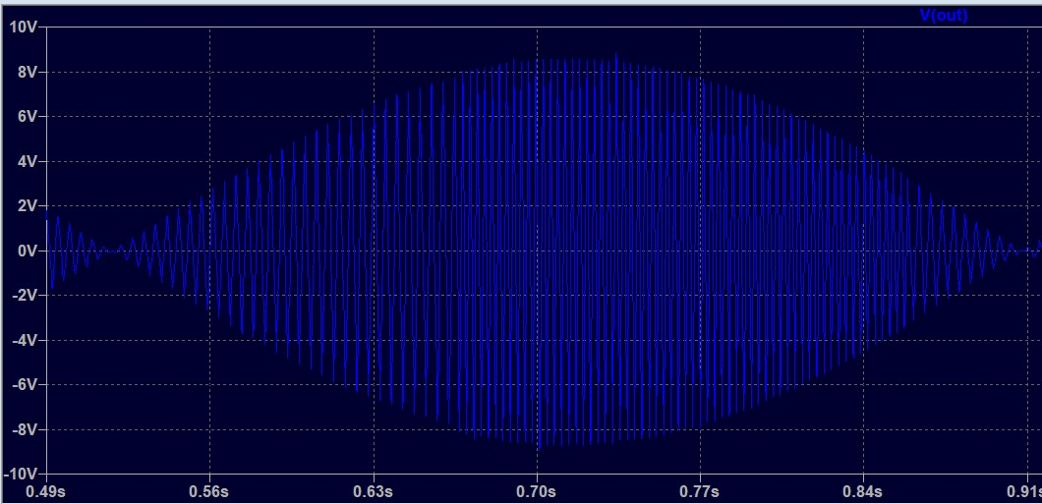
AM: LFO - sine (tremolo)
FM: LFO - square (trill)
Key: Key1
VCO: Triangle
This combination produces a muffled siren sound.

Slide 5
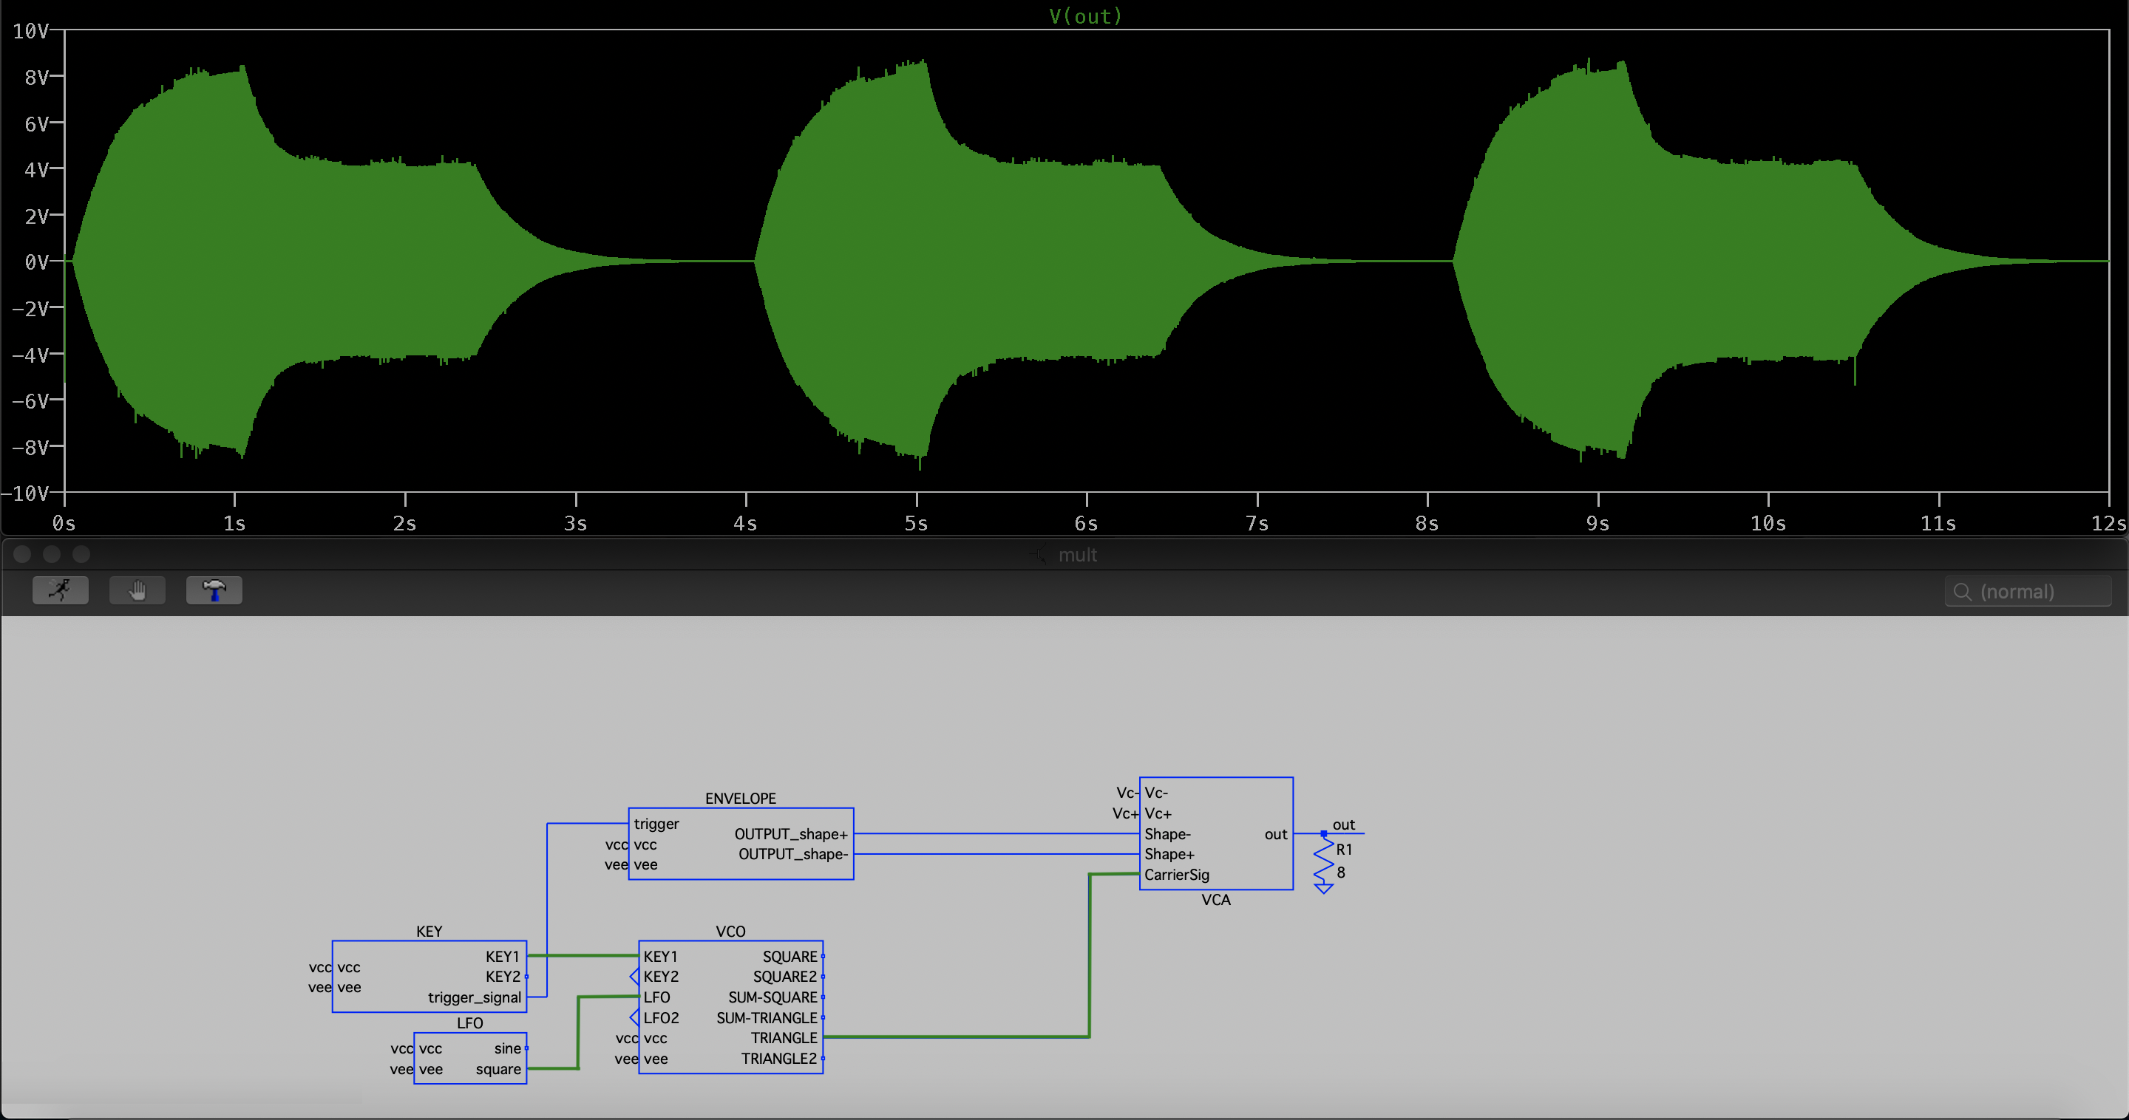
AM: Envelope
FM: LFO - square (trill)
Key: Key1
VCO: Triangle
This combination produces a muffled siren sound with fading at the end of the note

Slide 6
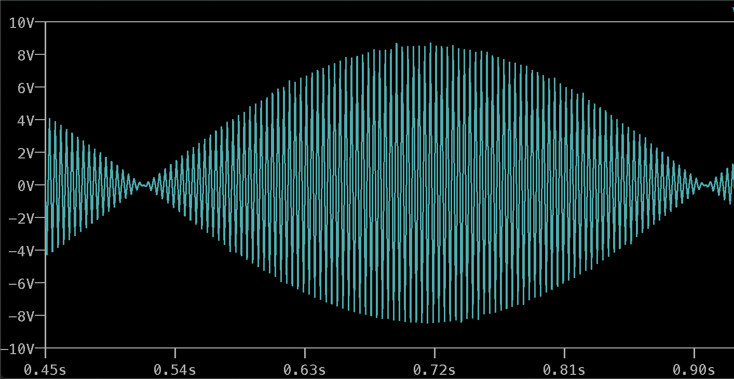
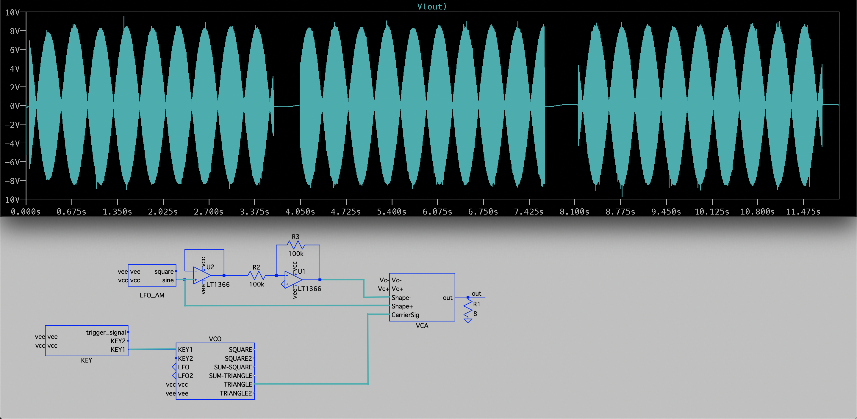
AM: LFO – sine (tremolo)
Key: Key1
VCO: Triangle
This combination varies the amplitude of the notes periodically.

Slide 7
Key1
Key2
Key1 + Key2
Key1 + Envelope
Key2 + Envelope
Key1 + Key2 + Envelope
Key1 + LFO (sine)
Key2 + LFO (sine)
Key1 + Key2 + LFO (sine)
Key1 + LFO (square)
Key2 + LFO (square)
Key1 + Key2 + LFO (square)
Key1 + LFO1 (sine)
Key1 + LFO1 (square)
Key2 + LFO2 (sine)
Key2 + LFO2 (square)
Key1 + LFO1 (sine) + Envelope
Key1 + LFO1 (square) + Envelope
Key2 + LFO2 (sine) + Envelope
Key2 + LFO2 (square) + Envelope
Key1 + LFO1 (sine) + LFO (sine)
Key1 + LFO1 (square) + LFO (sine)
Key2 + LFO2 (sine) + LFO (sine)
Key2 + LFO2 (square) + LFO (sine)
Key1 + LFO1 (sine) + LFO (square)
Key1 + LFO1 (square) + LFO (square)
Key2 + LFO2 (sine) + LFO (square)
Key2 + LFO2 (square) + LFO (square)
Key1 + Key2 + LFO1 (sine)
Key1 + Key2 + LFO1 (square)
Key1 + Key2 + LFO2 (sine)
Key1 + Key2 + LFO2 (square)
Key1 + Key2 + LFO1 (sine) + Envelope
Key1 + Key2 + LFO1 (square) + Envelope
Key1 + Key2 + LFO2 (sine) + Envelope
Key1 + Key2 + LFO2 (square) + Envelope
Key1 + Key2 + LFO1 (sine) + LFO (sine)
Key1 + Key2 + LFO1 (square) + LFO (sine)
Key1 + Key2 + LFO2 (sine) + LFO (sine)
Key1 + Key2 + LFO2 (square) + LFO (sine)
Key1 + Key2 + LFO1 (sine) + LFO (square)
Key1 + Key2 + LFO1 (square) + LFO (square)
Key1 + Key2 + LFO2 (sine) + LFO (square)
Key1 + Key2 + LFO2 (square) + LFO (square)
Key1 + Key2 + LFO1 (sine) + LFO2 (sine)
Key1 + Key2 + LFO1 (sine) + LFO2 (square)
Key1 + Key2 + LFO1 (square) + LFO2 (sine)
Key1 + Key2 + LFO1 (square) + LFO2 (square)
Key1 + Key2 + LFO1 (sine)
+ LFO2 (sine) + Envelope
Key1 + Key2 + LFO1 (sine)
+ LFO2 (square) + Envelope
Key1 + Key2 + LFO1 (square)
+ LFO2 (sine) + Envelope
Key1 + Key2 + LFO1 (square)
+ LFO2 (square) + Envelope
Key1 + Key2 + LFO1 (sine)
+ LFO2 (sine) + LFO (sine)
Key1 + Key2 + LFO1 (sine)
+ LFO2 (square) + LFO (sine)
Key1 + Key2 + LFO1 (square)
+ LFO2 (sine) + LFO (sine)
Key1 + Key2 + LFO1 (square)
+ LFO2 (square) + LFO (sine)
Key1 + Key2 + LFO1 (sine)
+ LFO2 (sine) + LFO (square)
Key1 + Key2 + LFO1 (sine)
+ LFO2 (square) + LFO (square)
Key1 + Key2 + LFO1 (square)
+ LFO2 (sine) + LFO (square)
Key1 + Key2 + LFO1 (square)
+ LFO2 (square) + LFO (square)
Pink – Keys Green – FM Blue - AM

